Slide 1
Stocking Presidents
October 8, 2019
Brian Groce, Diane Scherpereel, Roger J. Albarran

Slide 2
Motivation + Summary
Hypothesis – If the president influences the stock market, we would expect that the frequency of positive or negative close days, measured from election day to inauguration and total term of each President, would be greater than the market historical average from January 3, 2000 to September 27, 2019.
Null Hypothesis – If the president does not influence the stock market, we would expect that the frequency of positive or negative close days, measured from election day to inauguration and total term of each President, would be equal to the market historical average from January 3, 2000 to September 27, 2019.
Notes:
News was a major motivation
Read the null

Slide 3
Understanding the problem
Question 1
Question 2
Question 3
Does the President have an impact on the stock market?
Is there a difference between the frequency of positive or negative days when comparing presidents?
What are the changes to the Dow Jones Industrial Average from election to inauguration day and within a president's term?
Notes:
In this project, our team collected API daily stock data from Alpha Vantage to analyze if a President has an effect on the stock market.

Slide 4
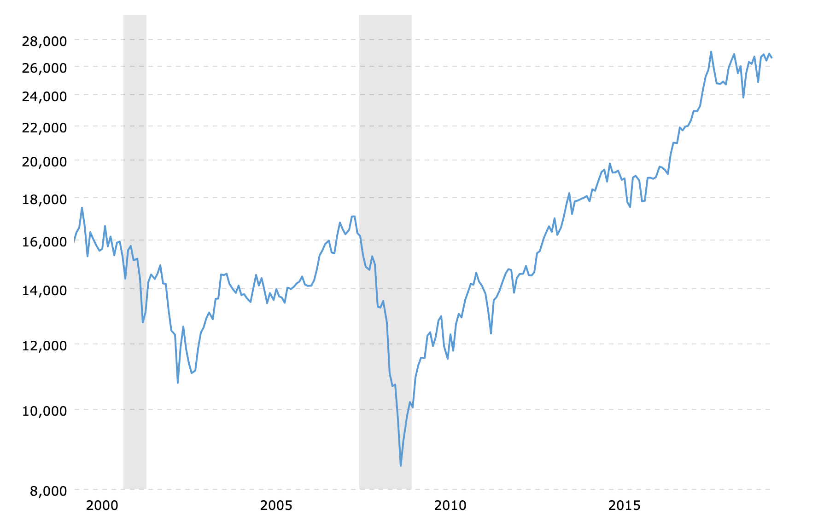
Data Exploration + Clean up

Slide 5
Data Analysis

Slide 6
Question 3
What are the changes to the Dow Jones Industrial Average from election to inauguration day and within a president's term?

Slide 7
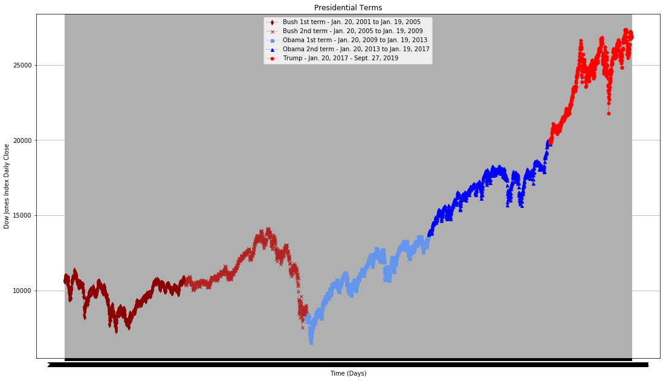

Slide 8
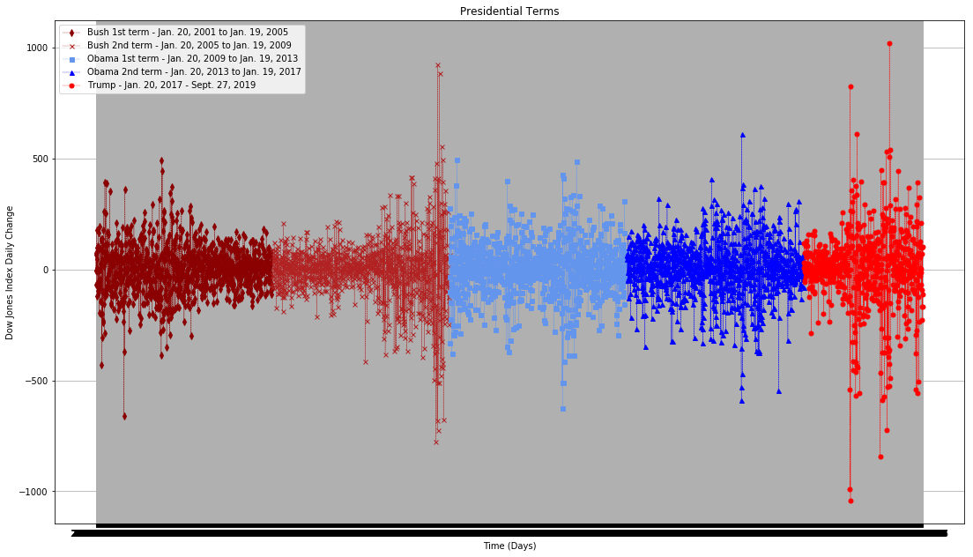

Slide 9
Question 2
Is there a difference between the frequency of positive or negative days when comparing presidents?

Slide 10
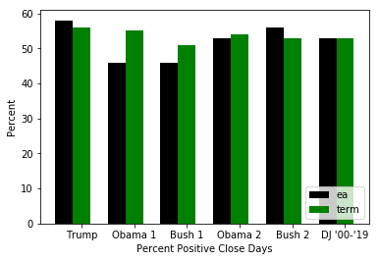
56
55
54
53
53
51
ea = Election to Inauguration
Notes:
Ea

Slide 11
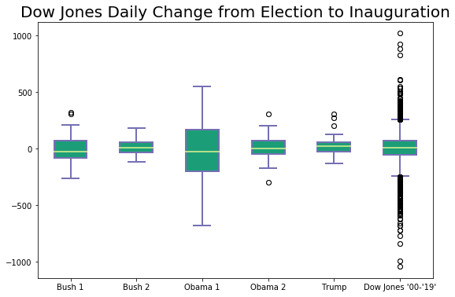

Slide 12
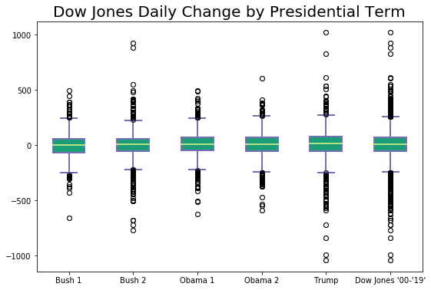

Slide 13
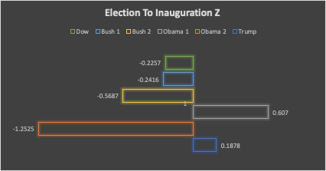
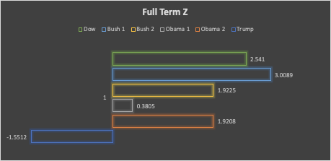
Wald-Wolfowitz runs test

Slide 14
Question 1
Does the President have an impact on the stock market?
Notes:
STOP AND ASK CLASS.

Slide 15
Discussion
Volatility
Uncertainty between election and inauguration
Presidential Term
Overall, minimal differences by term or by President
Failed to Reject the Null Hypothesis
Forces other than the President have a greater effect on the stock market.
Deliverable 4

Slide 16
References
Alpha Vantage (n.d.) https://www.alphavantage.co/
Dow Jones Historical Chart (20 year). https://www.macrotrends.net/1319/dow-jones-100-year-historical-chart
100 years DJ Industrial Average Chart (n.d). https://tradingninvestment.com/100-years-dow-jones-industrial-average-djia-events-history-chart/
Real Statistics Runs Distribution (Wald-Wolfowitz Runs Test) http://www.real-statistics.com/non-parametric-tests/one-sample-runs-test/runs-distribution/

